Slide 1



Slide 2
Autonomous System

Slide 3
RULES
  No side talks
  Phones are in silent mode
  Questions after each slide
  Take permission before leaving
  There will be a break during the session if you want to eat or drink
  Make sure to take notes about what is discussed

Slide 4
Session 2
“Autonomous Cars systems and their integration”

Slide 5

About the instructor
ٍHR member 2021
ٍSuspension and steering member 2021
Participated in EVER Egypt Rally competition 2021
Team Manager 2022
Autonomous Subteam head 2023

Slide 6
Agenda
  Sensors Motivation
  Quiz 1
  Break Time
  Perception
  Planning
  Quiz Time

Slide 7

To Complete the driving task we need:
Analyze the environment
Get data from the environment and analyze it to understand what is happening around and where we are (System input)
Decisions and Actions
Decide and plan to take actions and get the best solution based on given data (System Output)

Slide 8
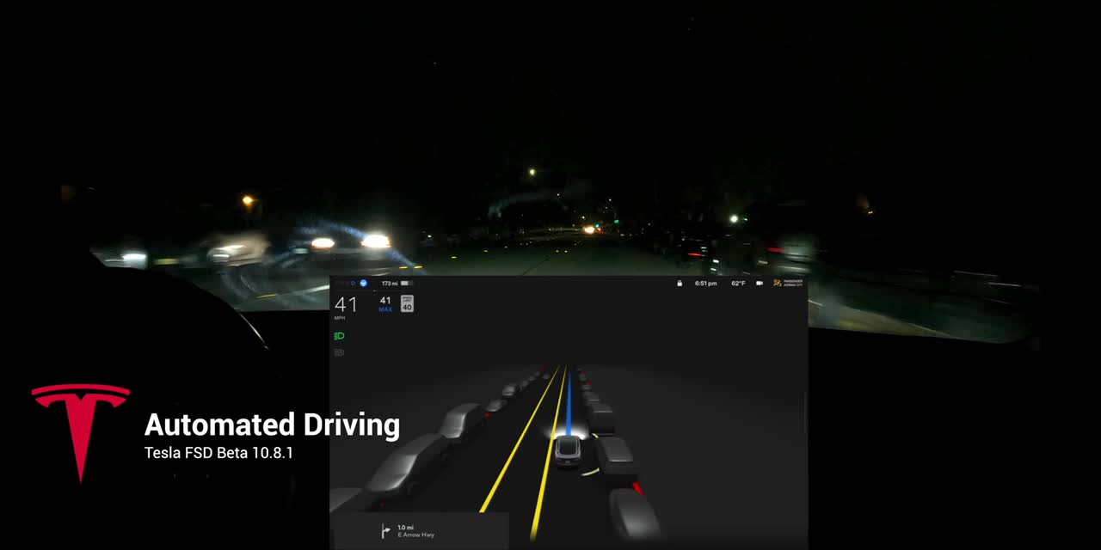
To Complete the driving task we need:
OEDR
Any driving task need some kind of object detection or event recognitions and then responding to it

Slide 9

Sensors
A sensor is a device that detects and responds to some type of input from the physical environment
Sensors input can be
Sensors ouyput can be
The input of a sensor varies depending on the type of sensor
The output is generally a signal that human can deal with
Light
Heat
Analog signal
Digital signal
Motion
  Pressure
Resistence
  Pulse Count

Slide 10

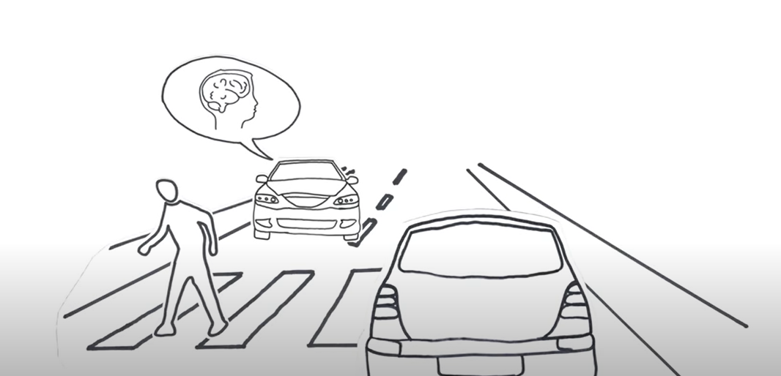
Sensors
Motion
  Pressure
Resistence
  Pulse Count

Slide 11

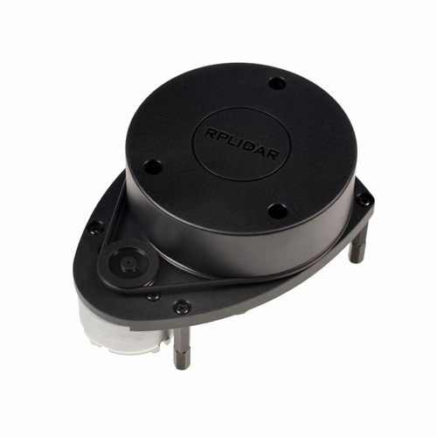
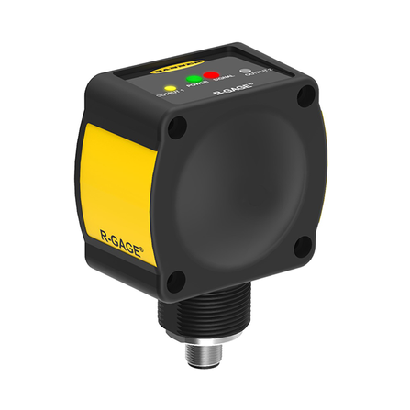
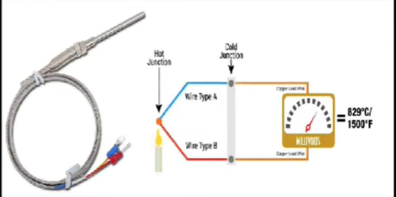
Remote sensing
Active
These are sensors that provides its own power source, No external power supply required. The sensor has the source of illumination
  Thermocouple
  Solar cell
  Lidar
  Radar

Slide 12
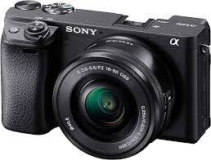
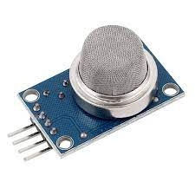
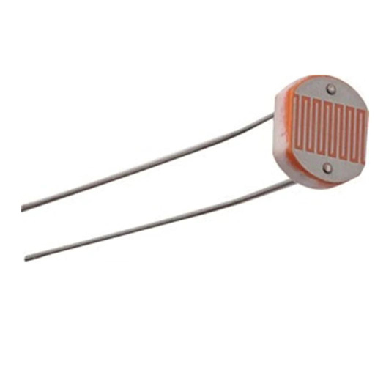
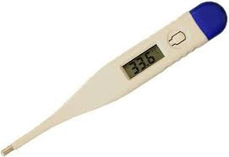
Remote sensing
Passive
is a device that detects and responds to some type of input from the physical environment
  Thermometer
  Camera
  Gas sensor
  light sensor

Slide 13
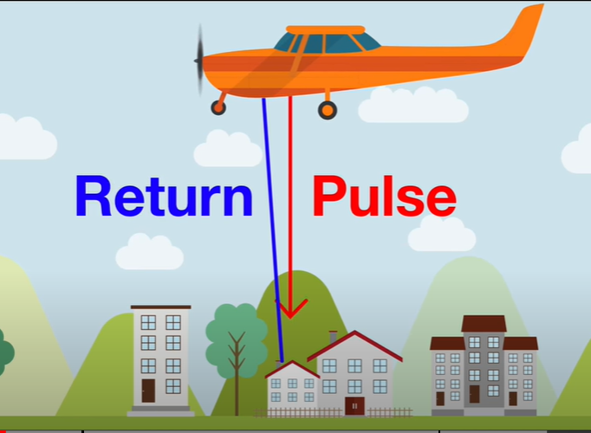
LIDAR Sensor
Light detection and ranging (Lidar) is a remote sensing method that uses laser to measure elevation like ground, forest and buildings
Light energy emitted by lidar system is known as “Pulse” and light reflected from objects is known as “Return”
The source of light is Laser

Slide 14
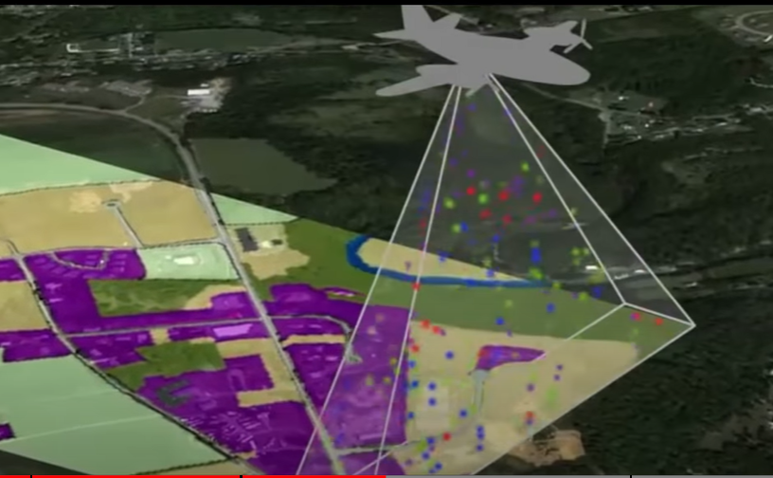
LIDAR Sensor
Light detection and ranging (Lidar) is a remote sensing method that uses laser to measure elevation like ground, forest and buildings
Light energy emitted by lidar system is known as “Pulse” and light reflected from objects is known as “Return”
The source of light is Laser works as an eye
of devices it is installed on

Slide 15
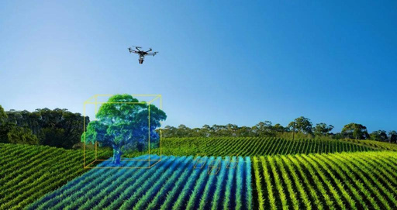
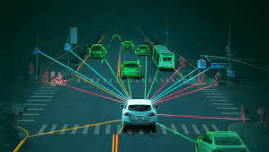
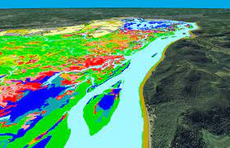
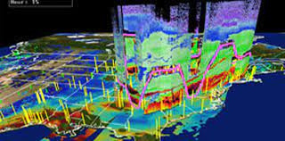
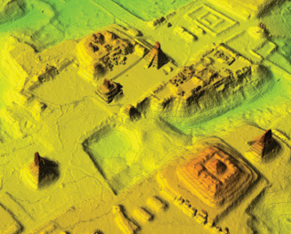
LIDAR Sensor
Lidar sensor is used in so may applications such as
  Autonomous
  Vehicles
  River Survey
  Archeology and building
  Agricalture
  Modelling

Slide 16
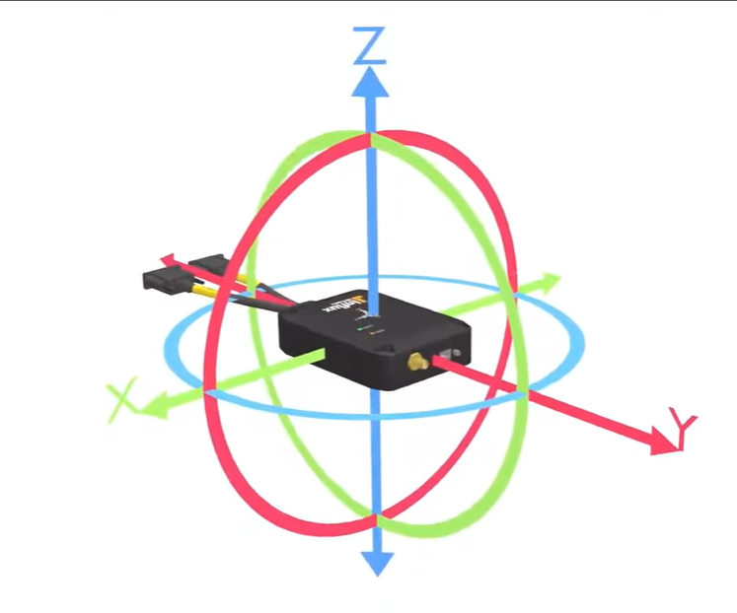
IMU
Inertial measurement unit is a combination of sensors that are used to measure the orientation and motion of the robot with respect to inertial reference frame
IMU sensor has two main types
  6-DOF
  9-DOF
-Gyroscope
-Accelerometer
-Gyroscope
-Accelerometer
-Magnetometer

Slide 17
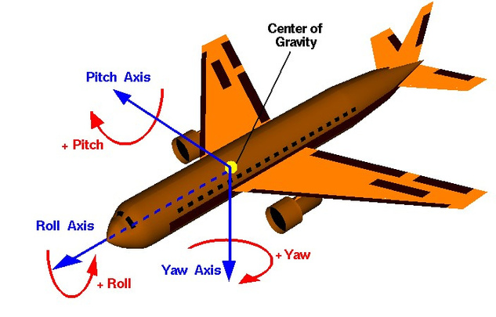
IMU
1- Gyroscope
It is used to measure the orientation angles and also angel rotation rate like how fast the robot rotates (rad or deg/s)

Slide 18
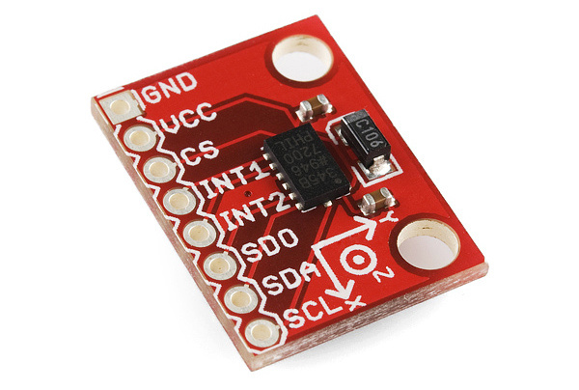
IMU
2- Accelerometer
Electromechanical device that converts mechanical forces such as motion, vibration and shock to an electric signal can be measured or recorded

Slide 19

Camera
It is a light proof box built to capture light
The camera works as the same way as human eyes.
it use lenses to focus light onto photosensitive sensors or film, creating images through exposure and processing

Slide 20
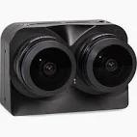
Stereo Camera
Stereo camera creates stereo vision using two cameras like two eyes to get a view from two angels at once and form a 3d image.
This Done through 3 steps:
  Tranformation
  Comparison
  Generation

Slide 21
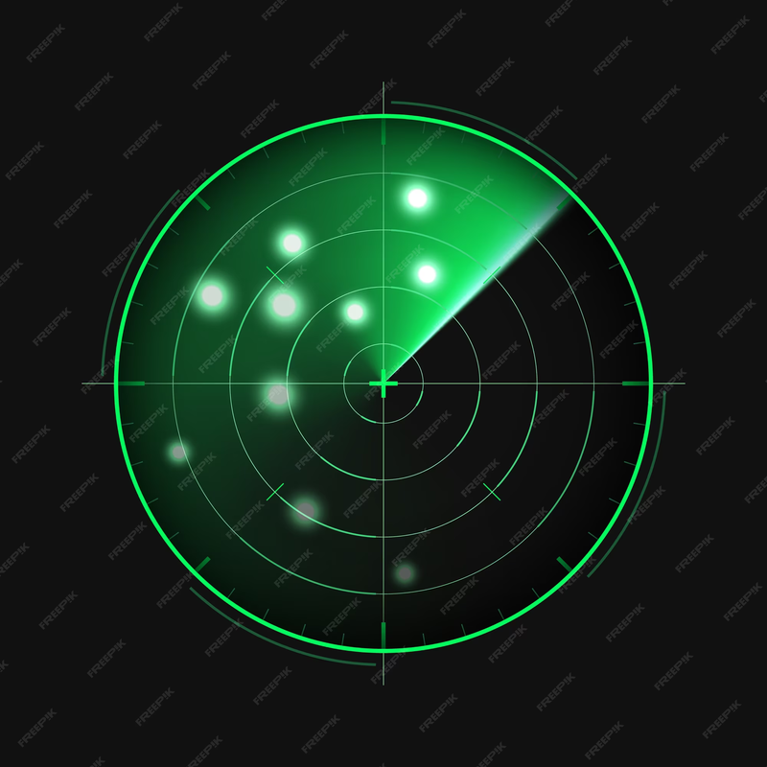
Radar
Radar (Radio Detection and Ranging) is a technology that uses radio waves to detect, locate, and track objects, often in aviation and meteorology

Slide 22
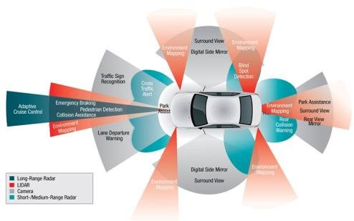
Ranges

Slide 23
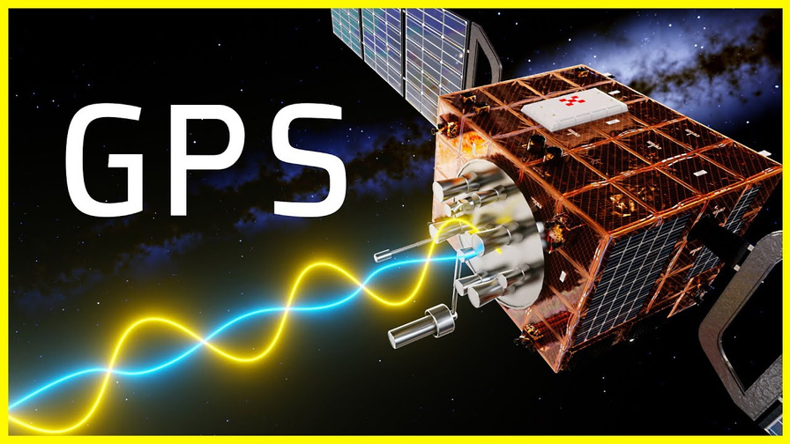
GNSS
Global navigation satellite system (GNSS) Provide position and velocity measurments used to estimate vehicle position and orientation.
GNSS works in conjunction with an Inertial Measurement Unit (IMU) to provide accurate data for vehicle position and orientation estimation

Slide 24
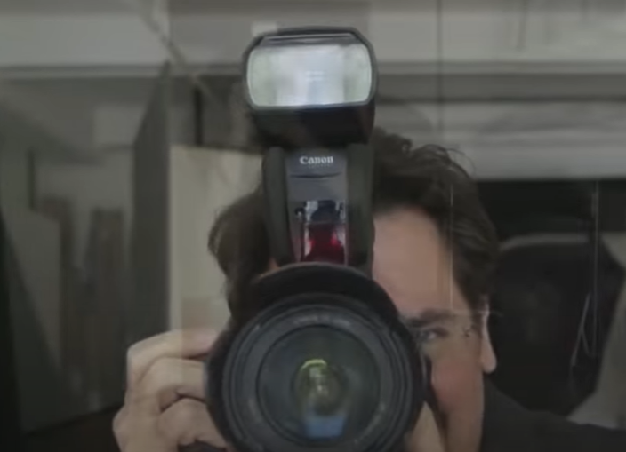
Quiz 1
Camera
with flash
  Active
  Passive

Slide 25
Quiz 1
  Active

Slide 26
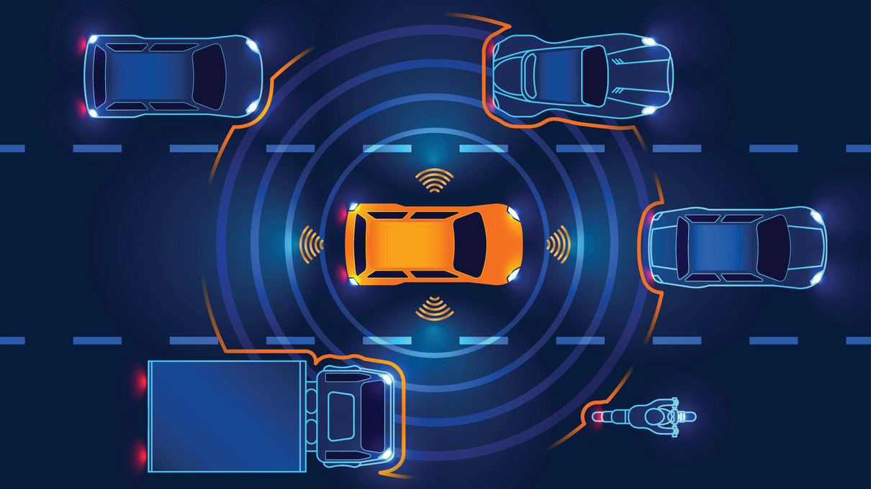
Perception
It is a sense of the environment around us and the way we are moving in it
For any Object we need :
Identification for what it is (car,bicycle,truch,etc...)
Understanding motion: is it static or dynamic

Slide 27
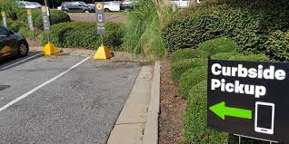


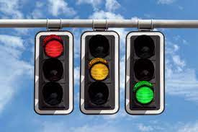
Goals of perception
  Identify static objects
  Curbside(off-road)
  SIgns(on-road)
  SIgns(off-road)
  Traffic lights
  (off-road)

Slide 28

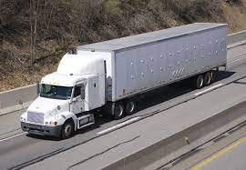
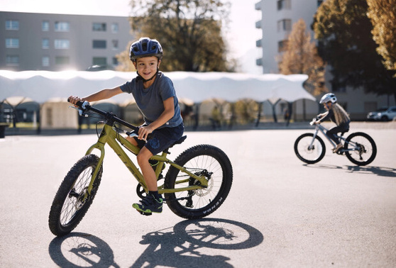
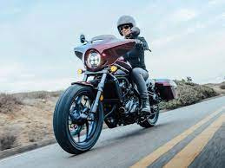
Goals of perception
2.Identify dynamic objects
  Pedestrians
  Trucks
  Bicycles
  Motorcycles

Slide 29
Goals of perception
3.Ego-Localization
Estimate where we are and how we are moving at any time
  Orientation
  Angular motion
  Acceleration
  Position
  Velocity

Slide 30
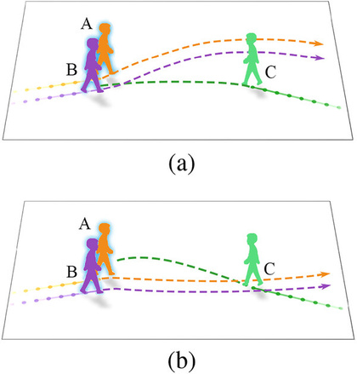

Challenges face perception
As humans, we are good at understanding patterns to take some actions. However, it is hard for a computer to recognize these patterns as fast as we do .
1.Detection Segmentation: Accessing a large dataset is critical. collecting data from all vehicle in all weather conditions is very tough and time consuming

Slide 31

Challenges face perception
2.Sensor uncertainty:
  GPS corruption or outage
  Visibility challenging
  Radar or lidar returns a noisy in terms of their position

Slide 32
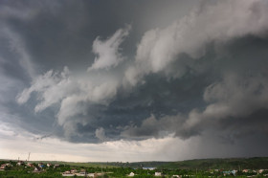
Challenges face perception
3.Occlusion :
These effect on confuse perception with ambiguous information that may hard to resolve into accurate estimation of object location

Slide 33

Challenges face perception
4.illuminationand lens flare:
These are effects like drastic illumination or lens flare that confuse the data reading about locations

Slide 34
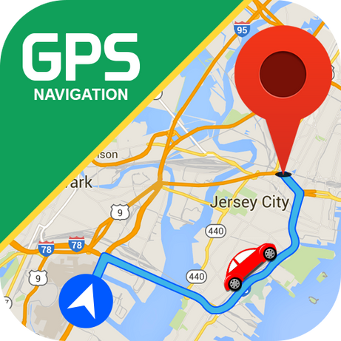
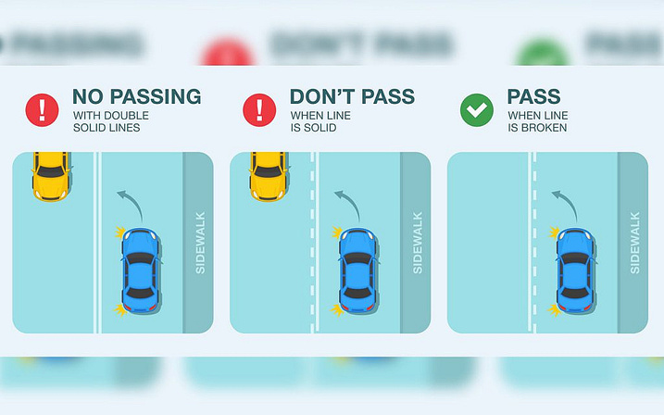
Make Decisions
1.Long term Planning: How to navigate from home to work? here we get (Mission plan)
2.Short term Planning: It come with questions like “Is is safe to change lanes or turn left?”

Slide 35

Make Decisions
3.Immediate Planning: involves trajectory planning like “How to follow my lane on curved road?” or “Should I brake or accelerate?”

Slide 36
Make Decisions
3.Immediate Planning: involves trajectory planning like “How to follow my lane on curved road?” or “Should I brake or accelerate?”
These scenarios rises suddenly through riding

Slide 37
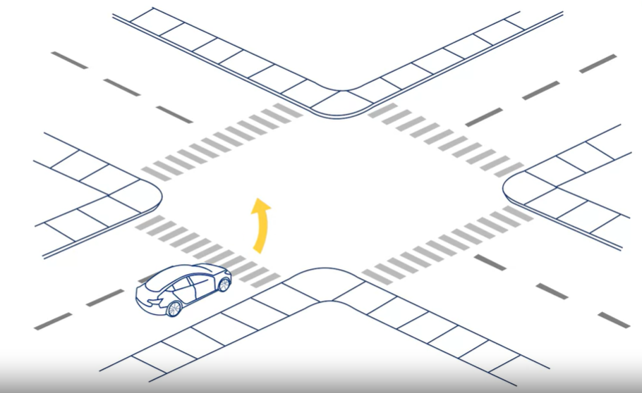
Senarios

Slide 38
Senarios
  Long term

Slide 39
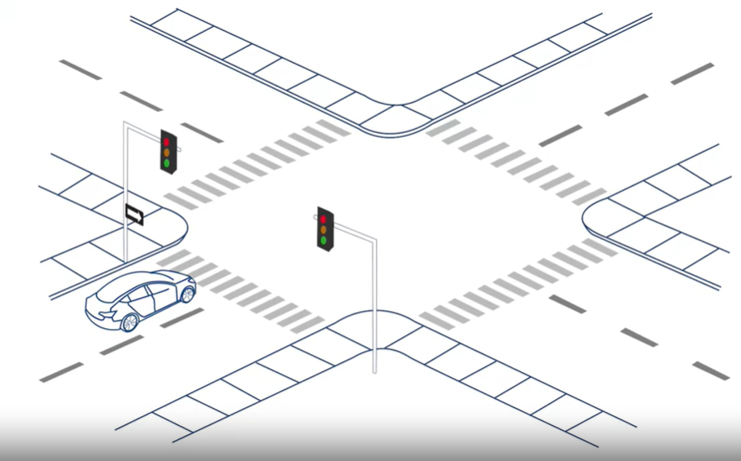
Senarios

Slide 40
Senarios
  Short term

Slide 41
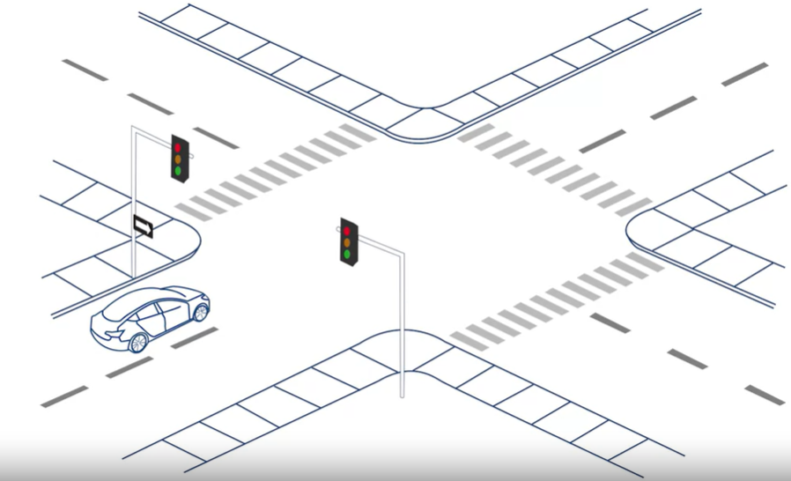
Senarios

Slide 42
Senarios
  Immediate planning

Slide 43
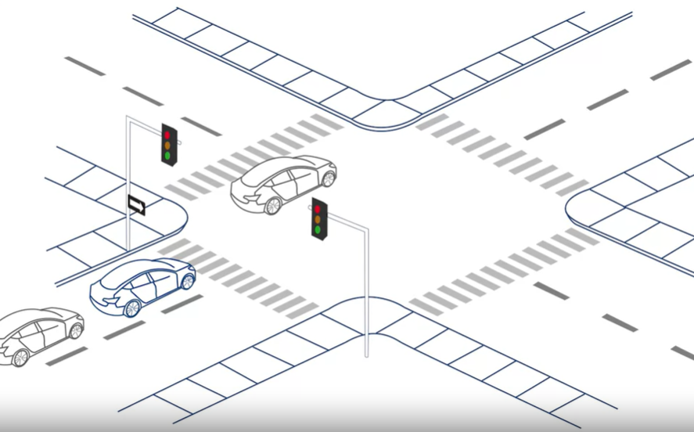
Senarios

Slide 44
Senarios
  Immediate planning

Slide 45
Important note
Any Simple driving scenario requires minimum
3-4 levels of decisions
  Safely
  Follow traffic rules
  Effecienly

Slide 46

Make Decisions
4.Rule based planning(Reactive):
Here we get some rules that take into account the current state ego and give decisions
Examples:
1-If there is a pedestrian, stop.
2-If speed limit changes, adjust to match it .

Slide 47

Make Decisions
5.Prediction planning:
Make decisions about other vehicles and how they are moving. then take action based on that prediction
Examples:
The car driving behind me increases its speed, it wants to change lane.

Slide 48
Quiz Time

Slide 49
What is the primary purpose of OEDR?
  Pulling over upon hearing sirens
  Measure the speed of moving objects
  Maintaining a distance to a vehicle ahead
  Enhance image resolution

Slide 50

What is the primary purpose of OEDR?
  Pulling over upon hearing sirens
  Measure the speed of moving objects
  Maintaining a distance to a vehicle ahead
  Enhance image resolution

Slide 51
Which of the following tasks are associated with perception ?(choose all that apply)
  Identifying road signs
  Estimating the motion of other vehicles
  Control and Actuation
  Enhance Simulations and Testing

Slide 52
Which of the following tasks are associated with perception ?(Select all that apply)
  Identifying road signs
  Estimating the motion of other vehicles
  Control and Actuation
  Enhance Simulations and Testing

Slide 53
You entered your autonomous vehicle and you decided to take a nap. for which levels of autonomous is it safe? (Select all that apply)
  Level 0
  Level 4
  Level 3
  Level 5

Slide 54
You entered your autonomous vehicle and you decided to take a nap. for which levels of autonomous is it safe? (Select all that apply)
  Level 0
  Level 4
  Level 3
  Level 5

Slide 55
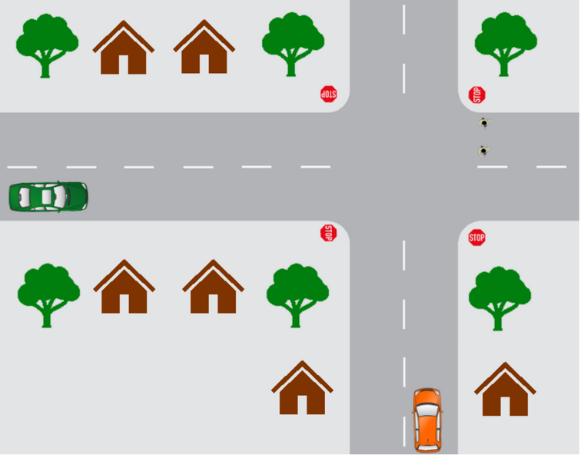
You are approaching an all way stop sign and you want to make a right turn . note : you are an orange car and there are 2 pedestrians crossing
The task involves multiple considerations which of them are predictive planning?
  Gradually decelerate while reaching the stop sign
  Wait for the pedestrians to finish crossing before turning
  At a stop sign, stop and look both ways before proceeding
  The green car arrives at the stop sign after you and plans to travel straight through the intersection. You choose to move first.

Slide 56
You are approaching an all way stop sign and you want to make a right turn . note : you are an orange car and there are 2 pedestrians crossing
The task involves multiple considerations which of them are predictive planning?
  Gradually decelerate while reaching the stop sign
  Wait for the pedestrians to finish crossing before turning
  At a stop sign, stop and look both ways before proceeding
  The green car arrives at the stop sign after you and plans to travel straight through the intersection. You choose to move first.

Slide 57
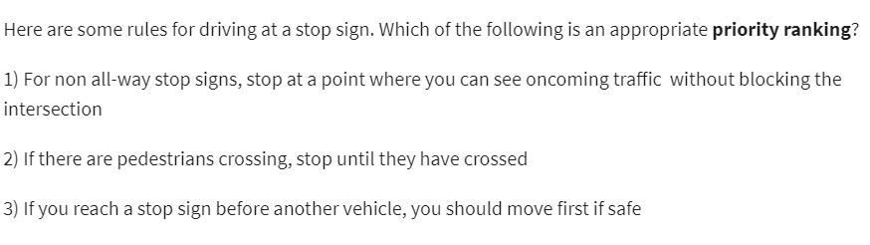
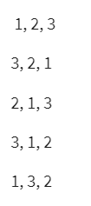

Slide 59
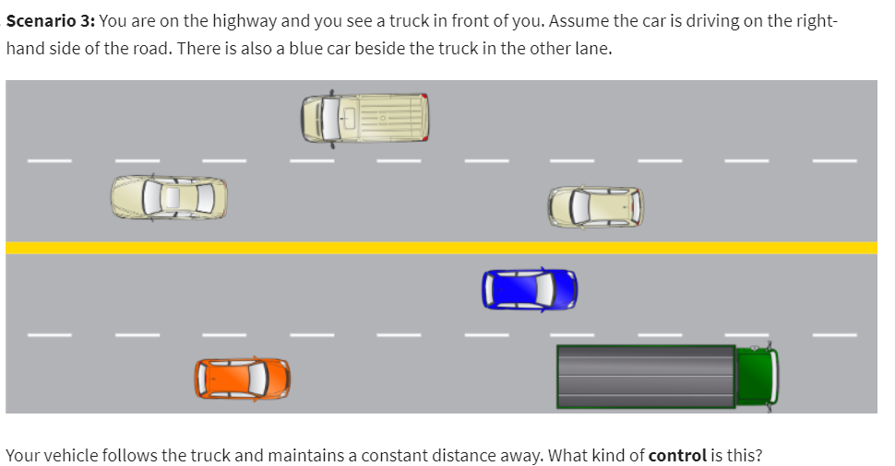
1.Longitudinal 2. Lateral 3. OEDR 4. Fullback

Slide 60
1.Longitudinal 2. Lateral 3. OEDR 4. Fullback

Slide 61
You decide to change lanes to pass the track
  Rule-based planning
  Immediate
  Long term planning
  Short term planning
  Reactive

Slide 62
You decide to change lanes to pass the track
  Rule-based planning
  Immediate
  Long term planning
  Short term planning
  Reactive

Slide 63
Thanks You

